Slide 1
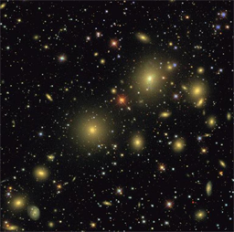
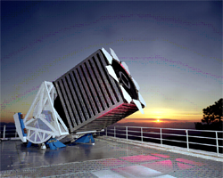
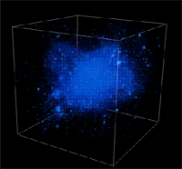
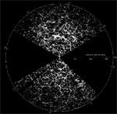
New Challenges in Large Simulation Databases
Alex Szalay
JHU

Slide 2
Data in HPC Simulations
HPC is an instrument in its own right
Largest simulations approach petabytes
from supernovae to turbulence, biology and brain modeling
Need public access to the best and latest through interactive numerical laboratories
Creates new challenges in
How to move the petabytes of data (high speed networking)
How to look at it (render on top of the data, drive remotely)
How to interface (smart sensors, immersive analysis)
How to analyze (value added services, analytics, … )
Architectures (supercomputers, DB servers, ??)

Slide 3
Cosmology Simulations
Data size and scalability
PB, trillion particles, dark matter
Where is the data located, how does it get there
Value added services
Localized (SED, SAM, star formation history, resimulations)
Rendering (viz, lensing, DM annihilation, light cones)
Global analytics (FFT, correlations of subsets, covariances)
Data representations
Particles vs hydro
Particle tracking in DM data
Aggregates, summary of uncertainty quantification (UQ)

Slide 4
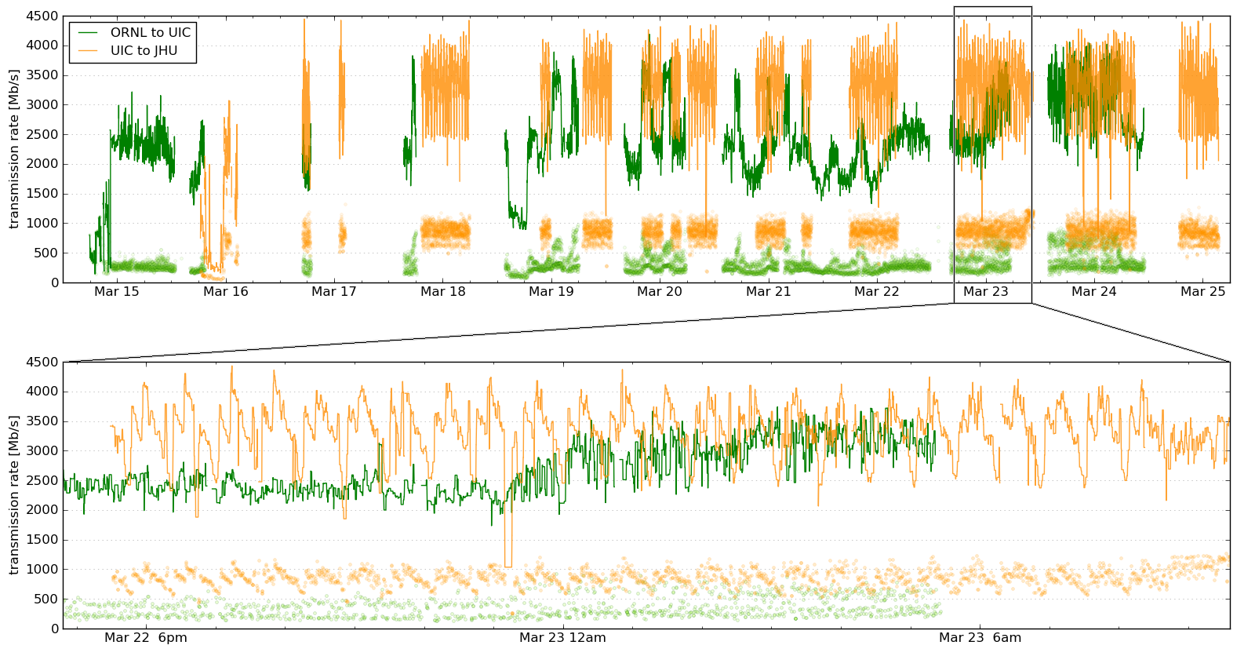
Silver River Transfer
150TB in less than 10 days from Oak Ridge to JHU using a dedicated 10G connection

Slide 5
Visualizing Petabytes
Needs to be done where the data is…
It is easier to send a HD 3D video stream to the user than all the data
Interactive visualizations driven remotely
Visualizations are becoming IO limited: precompute octree and prefetch to SSDs
It is possible to build individual servers with extreme data rates (5GBps per server… see Data-Scope)
Prototype on turbulence simulation already works: data streaming directly from DB to GPU
N-body simulations next

Slide 6
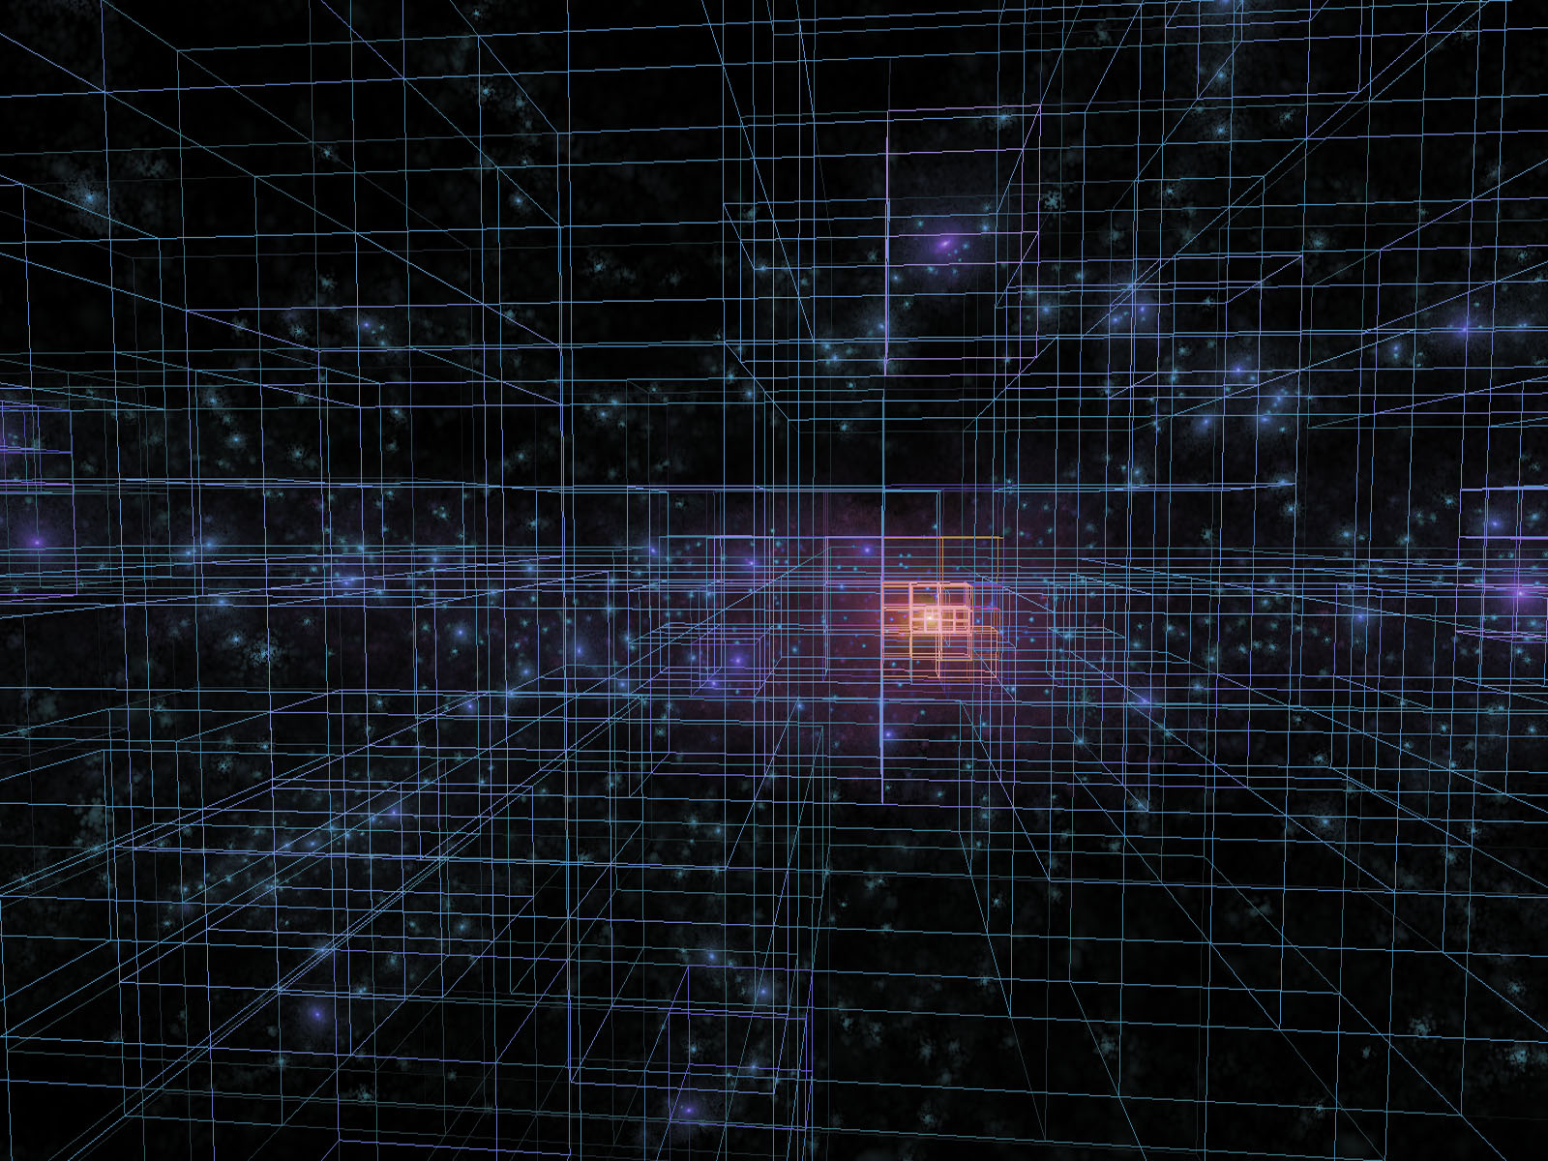
Real Time Interactions with TB
Aquarius simulation (V.Springel, Heidelberg)
150M particles, 128 timesteps
20B total points, 1.4TB total
Real-time, interactive on a single GeForce 9800
Hierarchical merging of particles over an octree
Trajectories computed from 3 subsequent snapshots
Tag particles of interest interactively
Limiting factor: disk streaming speed
Done by an undergraduate over two months (Tamas Szalay) with Volker Springel and G. Lemson
from T. Szalay, G. Lemson, V. Springel (2006)
http://arxiv.org/abs/0811.2055

Slide 7
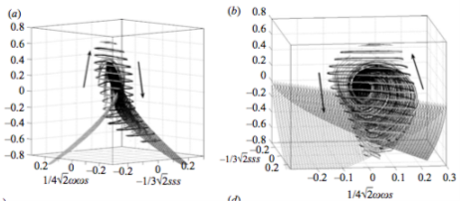
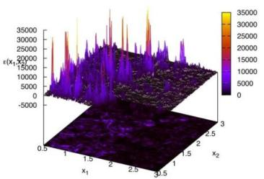
Immersive Turbulence
“… the last unsolved problem of classical physics…” Feynman
Understand the nature of turbulence
Consecutive snapshots of a large simulation of turbulence: now 30 Terabytes
Treat it as an experiment, play with the database!
Shoot test particles (sensors) from your laptop into the simulation, like in the movie Twister
Next: 70TB MHD simulation
New paradigm for analyzing simulations!
with C. Meneveau, S. Chen (Mech. E), G. Eyink (Applied Math), R. Burns (CS)

Slide 8
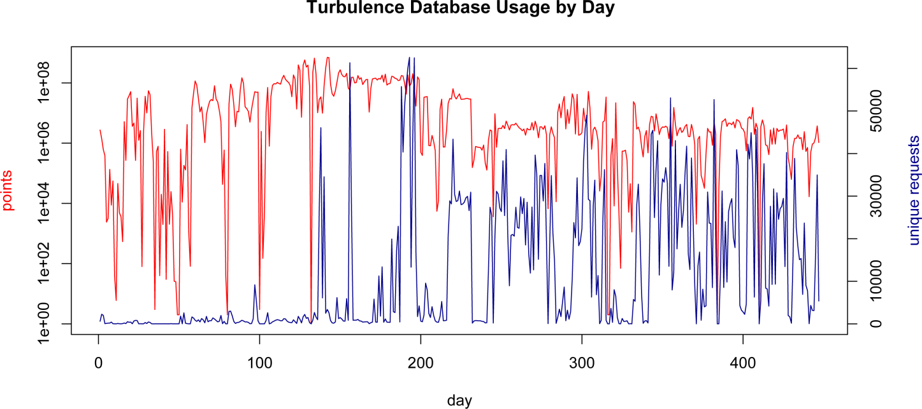
Daily Usage
2011: exceeded 100B points, delivered publicly

Slide 9
Streaming Visualization of Turbulence
Kai Buerger, Technische Universitat Munich, 24 million particles

Slide 10
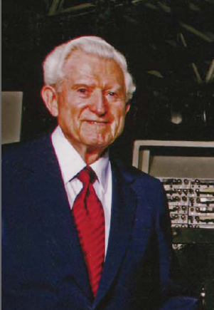
Amdahl’s Laws
Gene Amdahl (1965): Laws for a balanced system
Parallelism: max speedup is S/(S+P)
One bit of IO/sec per instruction/sec (BW)
One byte of memory per one instruction/sec (MEM)
Modern multi-core systems move farther away from Amdahl’s Laws (Bell, Gray and Szalay 2006)

Slide 11
Architectual Challenges
How to build a system good for the analysis?
Where should data be stored
Not at the supercomputers (too expensive storage)
Computations and visualizations must be on top of the data
Need high bandwidth to source of data
Databases are a good model, but are they scalable?
Google (Dremel, Tenzing, Spanner: exascale SQL)
Need to be augmented with value-added services
Makes no sense to build master servers, scale out
Cosmology simulations are not hard to partition
Use fast, cheap storage, GPUs for some of the compute
Consider a layer of large memory systems

Slide 12
Tradeoffs Today
Stu Feldman: Extreme computing is about tradeoffs
Ordered priorities for data-intensive scientific computing
Total storage (-> low redundancy)
Cost (-> total cost vs price of raw disks)
Sequential IO (-> locally attached disks, fast ctrl)
Fast streams (->GPUs inside server)
Low power (-> slow normal CPUs, lots of disks/mobo)
The order will be different every year…
Challenges today: disk space, then memory

Slide 13
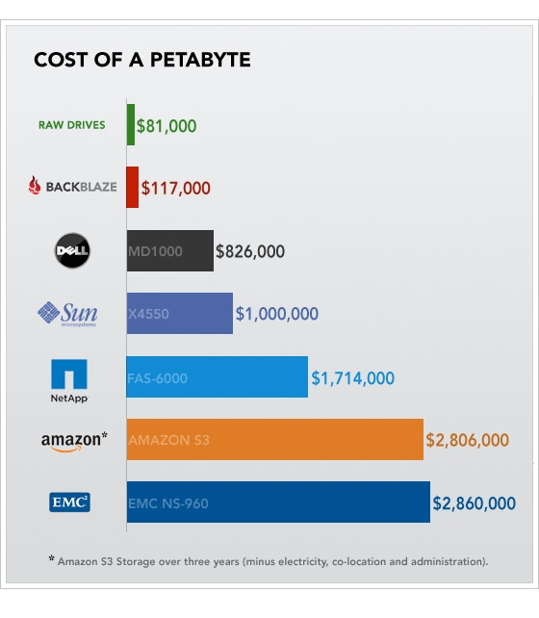
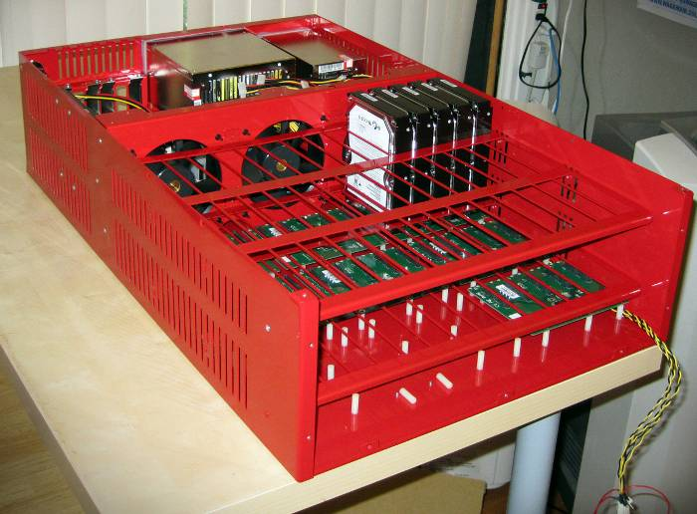
Cost of a Petabyte
From backblaze.com Aug 2009

Slide 14
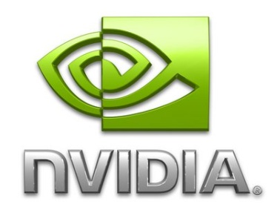
JHU Data-Scope
Funded by NSF MRI to build a new ‘instrument’ to look at data
Goal: ~100 servers for $1M + about $200K switches+racks
Two-tier: performance (P) and storage (S)
Mix of regular HDD and SSDs
Large (5PB) + cheap + fast (400+GBps), but … . ..a special purpose instrument
 | Final configuration
 | 1P | 1S | All P | All S | Full
servers | 1 | 1 | 90 | 6 | 102
rack units | 4 | 34 | 360 | 204 | 564
capacity | 24 | 720 | 2160 | 4320 | 6480 | TB
price | 8.8 | 57 | 8.8 | 57 | 792 | $K
power | 1.4 | 10 | 126 | 60 | 186 | kW
GPU* | 1.35 | 0 | 121.5 | 0 | 122 | TF
seq IO | 5.3 | 3.8 | 477 | 23 | 500 | GBps
IOPS | 240 | 54 | 21600 | 324 | 21924 | kIOPS
netwk bw | 10 | 20 | 900 | 240 | 1140 | Gbps

Slide 15
Cluster Layout
2 GPU
1 GPU
10Gbps
0 GPU
30P
720TB
30P
720TB
30P
720TB
1S
720TB
1S
720TB
1S
720TB
1S
720TB
1S
720TB
1S
720TB

Slide 16
Network Architecture
Arista Networks switches (10G, copper and SFP+)
5x 7140T-8S for the Top of the Rack (TOR) switches
40 CAT6, 8 SFP+
7050-S64 for the core
64x SFP+, 4x QSFP+ (40G)
Fat-tree architecture
Uplink to Cisco Nexus 7K
2x100G card
6x40G card
100G
Nexus 7K
3x40G (fiber)
7050-S64
5x40G (twinax)
7148
7148
7148
7148
7140T-8S

Slide 17
How to Use the Data-Scope?
Write short proposal (<1 page)
Bring your own data to JHU (10TB-1PB)
Get a dedicated machines for a few months
Pick your platform (Sci Linux or Windows+SQL)
Pick special SW environment (MATLAB, etc)
Partition the data
Start crunching
Take away the result or buy disks for cold storage

Slide 18
Crossing the PB Boundary
Via Lactea-II (20TB) as prototype, then Silver River (50B particles) as production (15M CPU hours)
800+ hi-rez snapshots (2.6PB) => 800TB in DB
Users can insert test particles (dwarf galaxies) into system and follow trajectories in pre-computed simulation
Users interact remotely with a PB in ‘real time’
INDRA (512 1Gpc box with 1G particles, 1.1PB)
Bridget Falck talk
Madau, Rockosi, Szalay, Wyse, Silk, Kuhlen, Lemson, Westermann, Blakeley

Slide 19
Large Arrays in SQL Server
Recent effort by Laszlo Dobos (w. J. Blakeley and D. Tomic)
User defined data-type written in C++
Arrays packed into varbinary(8000) or varbinary(max)
Also direct translation to Matlab arrays
Various subsets, aggregates, extractions and conversions in T-SQL (see regrid example:)
SELECT s.ix, DoubleArray.Avg(s.a) INTO ##temptable FROM DoubleArray.Split(@a,Int16Array.Vector_3(4,4,4)) s SELECT @subsample = DoubleArray.Concat_N('##temptable')
@a is an array of doubles with 3 indices
The first command averages the array over 4×4×4 blocks, returns indices and the value of the average into a table
Then we build a new (collapsed) array from its output

Slide 20
Using GPUs
Massive multicore platform emerging
GPGPU, multicores (Intel MIC/PHI)
Becoming mainstream (Titan, Blue Waters, Tsunami, Stampede)
Advantages
100K+ data parallel threads
An order of magnitude lower Watts/GF
Integrated with the database (execute UDF on GPU)
Disadvantages
Only 6GB of memory per board
PCIe limited
Special coding required

Slide 21
Galaxy Correlations
Generated 16M random points with correct radial and angular selection for SDSS-N
Done on an NVIDIA GeForce 295 card
600 trillion galaxy/random pairs
Brute force massively parallel N² code is much faster than tree-code for hi-res correlation function
All done inside the JHU SDSS SQL Server database
Correlation function is now SQL UDF (Budavari)

Slide 22
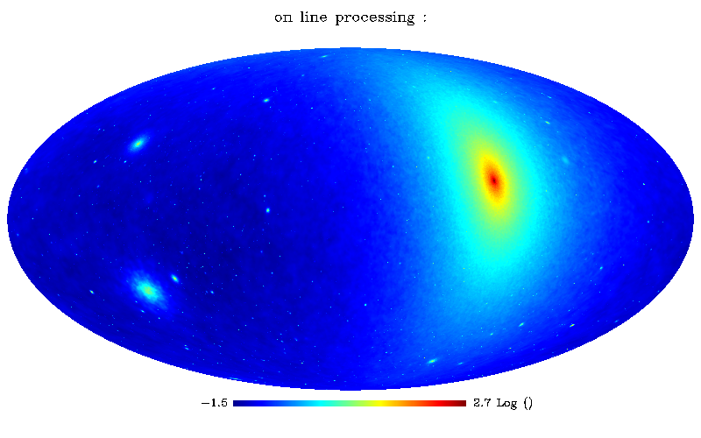
Dark Matter Annihilation
Data from the Via Lactea II Simulation (400M particles)
Computing the dark matter annihilation
Original code by M. Kuhlen runs in 8 hours for a single image
New GPU based code runs in 24 sec, Open GL shader lang. (Lin Yang, 2nd year grad student at JHU)
Soon: interactive service (design your own cross-section)
Would apply very well to lensing and image generation

Slide 23
Summary
Amazing progress in 7 years
Millennium is prime showcase of how to use simulations
Community is now using the DB as an instrument
New challenges emerging:
Petabytes of data, trillions of particles
Increasingly sophisticated value added services
Need a coherent strategy to go to the next level
It is not just about storage, but how to integrate access and computation
Filling the gap between DB server and supercomputer
Possible with an investment of about $1M=sqrt(10⁴x10⁸)
Justification: increase the use of the output of SC

