Slide 2
Resimulating objects selected from the database

Slide 3
Simulation infrastructure
Natural to use simulations in the database to select objects for further study.
Would be nice to automate this procedure so that it is relatively easy to make initial conditions for samples of object selected from the database.
This requires a number of steps. In this talk I will focus mainly just one aspect -- which is how to choose the phase information for new simulations for the database.
The choice of how phases are set up can help later when it comes to resimulating objects.

Slide 4
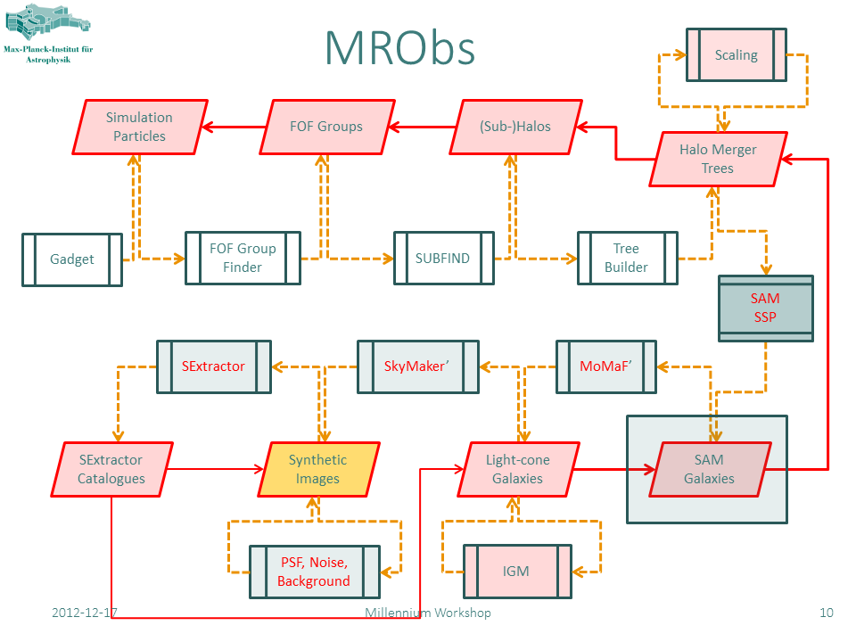
Phase information
ICs

Slide 5
Generating Gaussian random fields I
Useful to think of the task as consisting of two stages
Create a numerical approximation of a real Gaussian white noise field (i.e. a field with a constant power spectrum and a zero correlation function at non-zero lag).
Perform a convolution of this field with a real non-negative filter, to produce a Gaussian field with the desired power spectrum

Slide 6
Generating Gaussian random fields II
Gaussian white noise fields have a special property:
When expressed as a basis function expansion, the expansion coefficients are independent Gaussian random variables, provided the basis functions are mutually orthogonal.
Use a pseudorandom number generator to generate a set of `independent’ expansion coefficients.
The most familiar orthogonal basis functions for making initial conditions for structure formation calculations are planes waves.
This basis set is not ideal for making multi-scale or resimulation initial conditions because the basis functions are not localised.
There are better orthogonal basis sets …

Slide 7
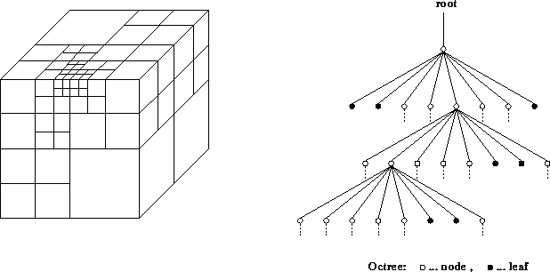
Octree basis functions
Establish a mapping between pseudorandom sequence and the octree cells.
If the entire pseudorandom sequence is used (e.g. 10⁴⁶ numbers) then huge dynamic range is possible. Much bigger than needed for any one simulation.

Slide 8
Publishing phase information
Public multi-scale Gaussian white noise field.
Eagle - 100 Mpc
MXXL -3000Mpc/h
The phases can be specified by 5 integers.
For example: Eagle volume phases are:
[L16,(31250,23438,39063),S12]

Slide 9
How do you make resimulation initial conditions?
Starting point is to take IC-GEN code and make minimal changes.
This code has been used to make ics for cosmological volumes: e.g. MXXL
Resimulations such as the Aquarius resimulations (Zeldovich approx)
Phoenix resimulations (2lpt approx)

Slide 10
How do you make resimulation initial conditions?

Slide 11
How do you make resimulation initial conditions?
Use octree basis functions as the building blocks
Several advantages over using white noise field itself:
Each grid is completely independent of the others. The displacements add incoherently.
By construction the zeroth and first moments of the octree basis functions are identically zero. This means their contribution is highly localised which mitigates edge effects due to unwanted periodicity.
For the inner grids need to decide on which grid to place each octree basis function.

Slide 13
How do you test the resimulations ics?
By making the same initial conditions with two different methods:
Cosmological ICS – use a single huge Fourier transform
Resimulation ICS – use nested multiple smaller FTs
Use the same particle load, N-body code, numerical parameters, and look at the final conditions to judge success.
Taken a MW-mass halo from DOVE/COCO simulation to test the ics.

Slide 14
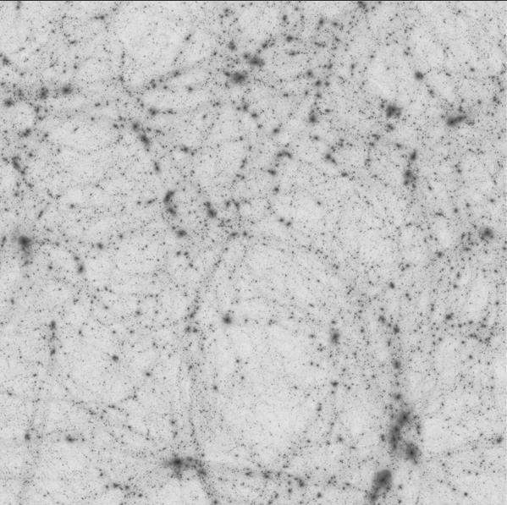
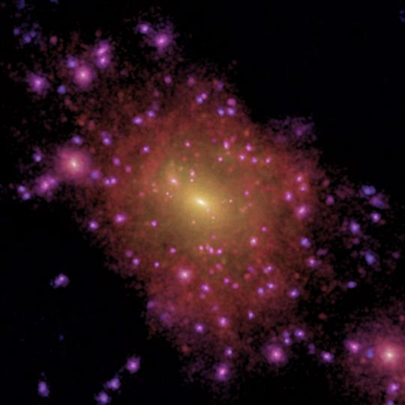
© Mark Lovell
Eagle Volume:
DOVE simulation
Reference halo: M₂₀₀=9.1x10¹¹Msun/h
Run with a 12288³ Fourier transform!

Slide 15
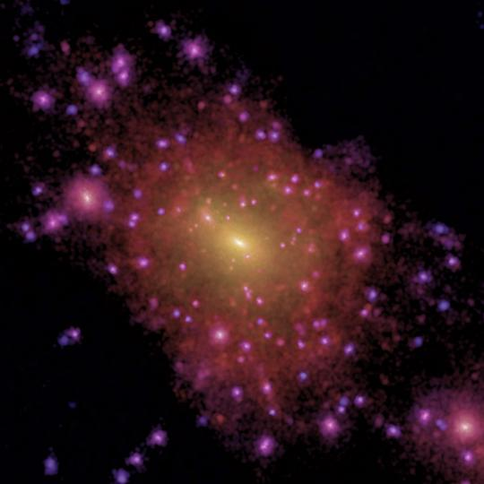
© Mark Lovell
Reference simulation Resimulation

Slide 16
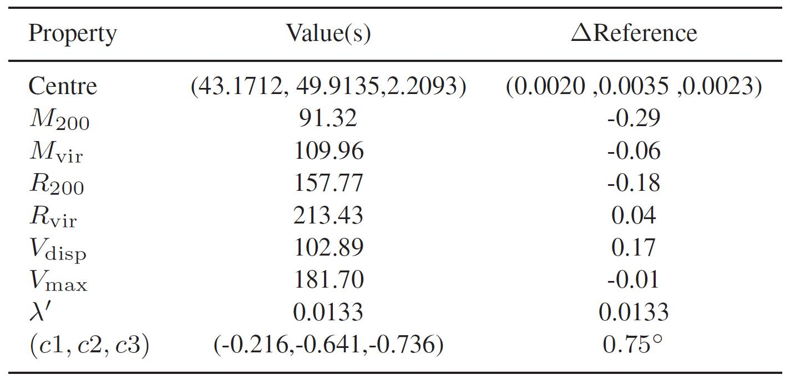
The properties of the resimulated halo agree very closely with the reference calculation.
0.000

Slide 17
© Mark Lovell
Reference simulation Resimulation

Slide 18
To COCO resolution and beyond …
© Mark Lovell
From COCO simulation Resimulation

Slide 19
Resimulating an object found in a database
Given the simulation and the position of the object – the phase information is easy to determine.
Need to be able to trace a Lagrangian region from which it formed.
Requires particle data at the epoch of identification. Not necessarily at the full resolution.
Making an economical Lagrangian region is hard, a more modest aim would be to make a generous region.
Need a code to generate the particle load.
A single compute node (with ~100 Gbytes RAM) needed to make most ICs.

Slide 20
Summary
Taking care with setting the phases for simulations can add value
There is new way to set the phase information using octree basis function expansions which has several advantages:
Consistent initial conditions over all scales
Ease of reproducibility – aiding sharing and publication of phase information.
Designed to allow very faithful resimulations
Databases are a natural place to look for objects or regions to resimulate for many purposes.
The ability to make resimulation initial conditions of objects/regions selected from the database would be nice!
Some one has to do the work …

